Slide 1
Exploring Factors Influencing Credit Risk Assessment
Vishnu Sai Muppalla
Jani Shariff Shaik

Slide 2
Overview
The objective of this project is to investigate the factors influencing credit risk assessment using a dataset containing demographic, financial, and loan-related information.
Notes:
By analyzing the dataset and building model, we aim to gain insights into the key determinants of creditworthiness and to check the probability of credit risk assessment.

Slide 3
Process
LOAD DATASET INTO R.
HANDLE MISSING VALUES, OUTLIERS, AND CATEGORICAL VARIABLES APPROPRIATELY.
MAKE INFERENCE FOR RESEARCH QUESTIONS.
PERFORM STATISTICAL MODELING

Slide 4
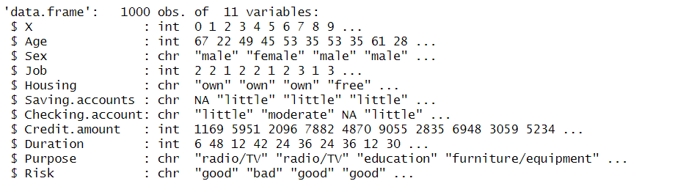
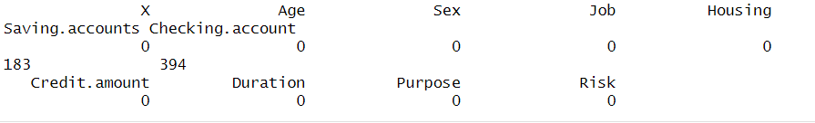
Initial Look
Data Cleaning
Notes:
We used the GermanCredit dataset that we pulled out from the Git hub. It contains 11 characteristics and 1000 observations, with a target variable (Credit risk) asdefined. The response variable is coded 0 for good and 1 for bad in the later stages.

Slide 5
Research Questions
Notes:
Our project aims at answering few research questions based on dataset and Domain Knowledge.

Slide 6
What is the impact of Number of Jobs on creditworthiness?

Slide 7
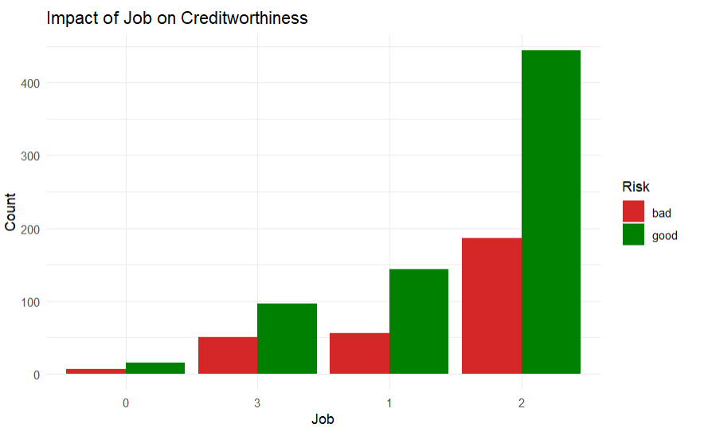

The Chi-square test results indicate that there is no significant association between no of jobs and creditworthiness (Risk) (χ² = 1.8852, df = 3, p = 0.5966, α = 0.05). Thus, we fail to reject the null hypothesis, suggesting that job category does not have a significant impact on credit risk.
Notes:
We perform certain tests that will help us understand if there are any significant relationships or differences between the variables and credit risk.

Slide 8
Does the type of housing (own, rent, or free) affect the likelihood of good credit risk?

Slide 9
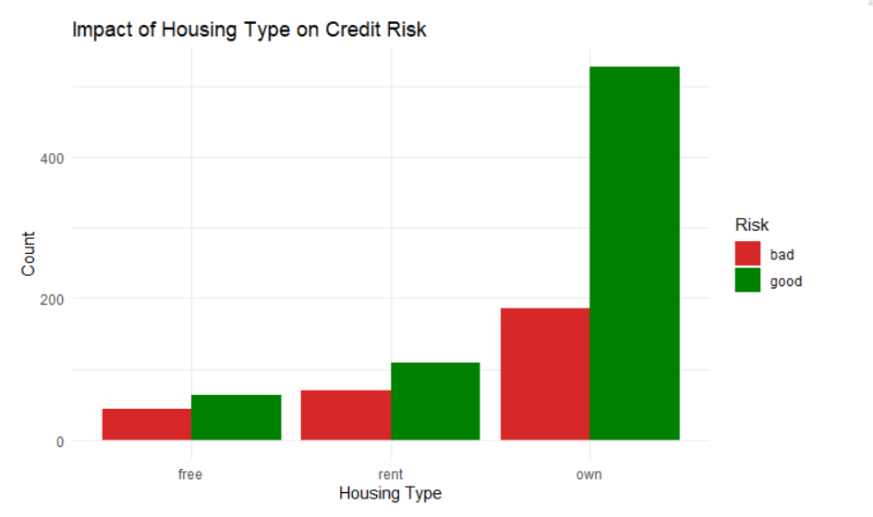
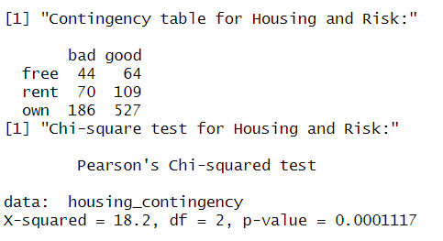
The low p-value (< 0.05) indicates that there is a significant association between housing type and credit risk. Therefore, housing type may be a relevant factor in determining credit risk.

Slide 10
How do different levels of saving and checking accounts (e.g., little, moderate, rich) relate to credit risk?

Slide 11
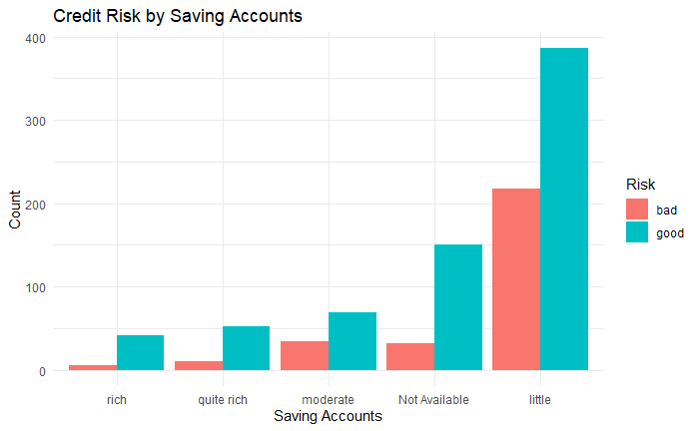
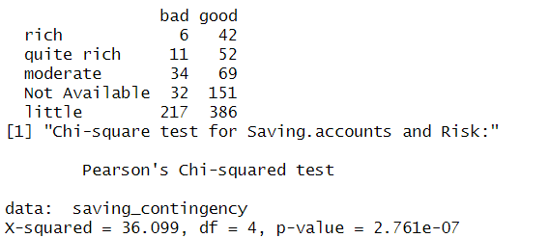
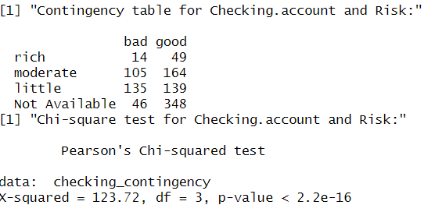
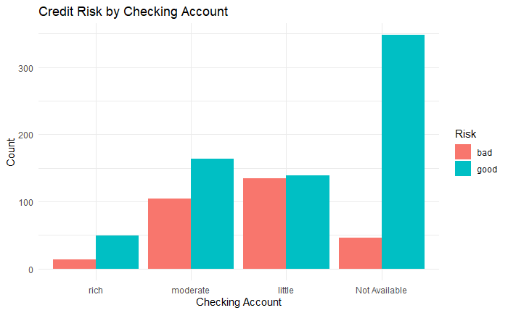
In summary, both saving and checking accounts show significant associations with credit risk. Individuals with certain levels of saving and checking accounts may exhibit different credit risk profiles, highlighting the importance of these financial factors in assessing creditworthiness.

Slide 12
What is the relationship between the amount of credit requested and credit risk?

Slide 13
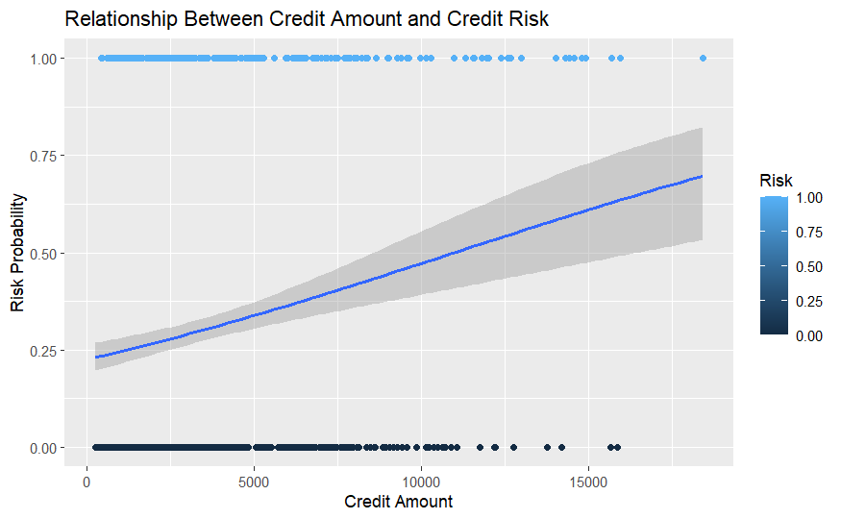

The output shows the log odds ratio, which is approximately 1.229 for the intercept and approximately -0.0001 for the coefficient of "Credit.amount". The positive log odds ratio for the intercept suggests a higher likelihood of good credit risk when "Credit.amount" is zero, while the small and negative coefficient for "Credit.amount" indicates a very slight decrease in the log odds of good credit risk as "Credit.amount" increases, though this effect seems negligible.

Slide 14
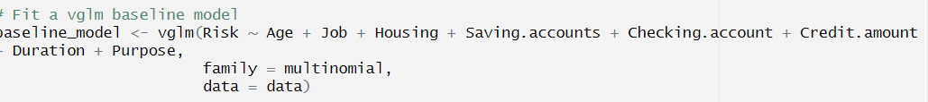
STATISTICAL MODEL
Notes:
The Vector Generalized Linear Model (VGLM) is an extension of the Generalized Linear Model (GLM) that allows for the modeling of multivariate responses. It accommodates a wide range of response distributions (e.g., binomial, Poisson, gamma) and link functions (e.g., logit, log, identity) simultaneously.

Slide 15
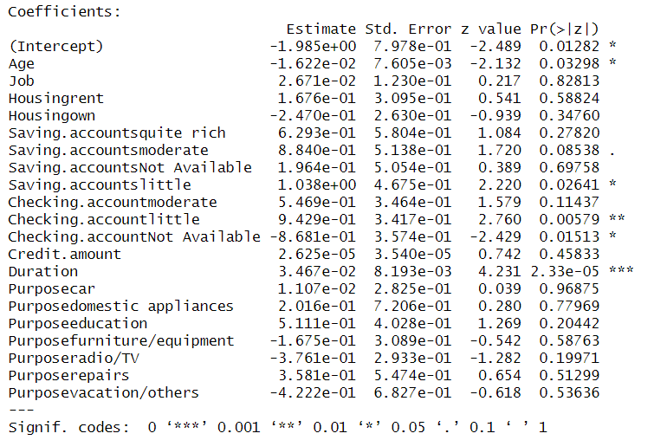
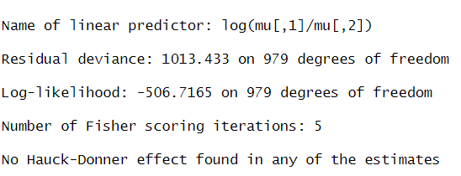
Results

Slide 16
Interpretation
Residual deviance : The residual deviance measures how well the model fits the observed data. A lower value indicates a better fit. In this case, the residual deviance is 1013.433 on 979 degrees of freedom.
Log-likelihood : The log-likelihood is a measure of how well the model predicts the observed data. A higher log-likelihood value indicates a better fit. In this case, the log-likelihood is -506.7165 on 979 degrees of freedom.
Overall, the model suggests that age, duration, and certain categories of saving and checking accounts have a significant association with credit risk, while other variables such as job, housing, and credit amount do not show a significant association.

Slide 17
Thank you. Please feel free to ask any questions. 😄

